Slide 1

AI ENABLED INTEGRATED APPLICATION FOR LUGGAGE CAREER SYSTEM
AJAY KUMAR GARG ENGINEERING COLLEGE, GHAZIABAD
Project Presentation on
Guided By
Ms. Akansha Shukla
Presented By,
Atish Gorka (2000270110026)
Gaurav Singh (2000270110040)
Kartikey Tyagi (2100270119005)
Sahastranshu Mishra (2000270310134)

Slide 2

ABSTRACT
The importance of a luggage carrier system in today's era lies in its ability to address the challenges posed by increased travel, globalization, security concerns, and technological advancements. By providing efficient, secure, and data-driven solutions, these systems play a crucial role in shaping the future of the transportation and logistics industry.
This project implements, AI integrated services into the logistic management application to enables the tasks such as parcel similarity detection, travel time detection, upcoming hubs tracking and the destination suitability prediction for safe travel of the upcoming hubs. If there is a lack of possibility found then the good route will be suggested to reach the next hub. Also integrated GPS services in order to identify the present location and routes.
The luggage’s location will be traced when transporting one hub to another and if the luggage’s location getting changed more than a particular range then the notification will be sent to the previous and oncoming hub managers and the map will be created for the luggage present location. Upon the luggage reaching the next hub, the system will generate goods receiving notes. Subsequently, a comparison between the source image and the received parcel image will take place.

Slide 3
ABSTRACT
If there is any missing luggage detected, a notification alert will be sent to the hub managers via email. OTP authentication is one of the major practices in the industries. But there are lot of fraudulent activities are arrived with OTP based authentication. To overcome this, the project introduces OTP encoded QR code-based authentication mechanism for authenticate the receiver. Also the sentimental analysis is implemented in order to analyse the customer feedbacks and queries to further improvement of the system.
This project reduces the man power in the process of parcel verification, routing and tracking. The location-based transport zone comfortability detection reduces the complexity of traveling in inauspicious areas. The QR based authentication reduces the risk of unaffiliated threads using OTP to commit fraud.

Slide 4
INTRODUCTION
The AI-enabled integrated application for a luggage carrier system represents a cutting-edge solution poised to revolutionize the efficiency, security, and overall experience within the logistics and transportation industry. By seamlessly merging artificial intelligence with sophisticated logistics management, this innovative application promises to optimize every facet of the luggage transit process. F
From automated route optimization based on real-time data to predictive maintenance leveraging advanced algorithms, the system ensures a streamlined and reliable service. Incorporating technologies such as GPS, RFID, and encryption based security, the application not only tracks the real-time location of luggage but also prioritizes security through advanced authentication measures.With features like image recognition for sorting, environmental impact analysis, and comprehensive data analytics for business intelligence, this AI-enabled application represents a holistic approach to modernize and enhance the luggage carrier ecosystem.

Slide 5
PROBLEM STATEMENT
The current luggage carrier system faces several challenges that impede operational efficiency and customer satisfaction. These challenges include suboptimal route planning, unreliable maintenance practices leading to unexpected downtimes, lack of real-time tracking causing inconvenience for travelers, and manual sorting processes that are prone to errors. Security concerns and the need for improved customer service also persist.
Additionally, the absence of integrated AI solutions results in missed opportunities for data-driven decision-making and proactive system management. In light of these challenges, there is a critical need for an AI-enabled integrated application for the luggage carrier system.
This solution aims to address inefficiencies, enhance security measures, and elevate the overall customer experience by leveraging artificial intelligence for optimized route planning, predictive maintenance, real-time tracking, automated sorting, and intelligent customer interactions. The objective is to create a seamlessly connected and technologically advanced luggage carrier system that not only meets industry standards but sets new benchmarks for reliability, efficiency, and passenger satisfaction.

Slide 6
OBJECTIVE AND SCOPE
The objective of the system that is aim to transform the luggage carrier system into a technologically advanced, secure, and customer-centric service that sets new standards for efficiency, reliability, and user satisfaction.
The scope of this project is extensive, with potential applications in various platforms, including transportation, goods delivery services, logistic services and even small scale industries to manage and maintain their luggage with ease.

Slide 7
LITERATURE STUDY
S. No | Author(s) | Title | Overview
1 | P. L. Santhana Krishnan et. Al | Smart Luggage Carrier system with Theft Prevention and Real Time Tracking Using Nano Arduino structure | In this work a IOT based luggage career drop system developed in order to provide a auto trail services in airport
2 | Komal Jotiba Dalvi et. al | Smart Luggage Carrier | In this work biometric based verification system proposed for the luggage carer delivery

Slide 8
LITERATURE STUDY
S. No | Author(s) | Title | Overview
1 | E. Teraence et. al | Smart Luggage Carrier System | In this work a IOT based luggage career drop system developed for the back ache people
2 | Sudha Senthilkumar et. al | Luggage Tracking System Using IOT | In this work a alerting system is implemented when a luggage is theft

Slide 9
LITERATURE STUDY
S. No | Author(s) | Title | Overview
5 | Nestor et. al | A Luggage Control System Based on NFC and Homomorphic Cryptography | In this work the author developed a application which trace the luggage details until it claim
6 | Peter D. DeVries | The state of RFID for effective baggage tracking in the airline industry | This article examines the state of Radio Frequency Identification (RFID) as a solution to the problem of tracking baggage within the commercial aviation industry.

Slide 10
LITERATURE STUDY
S. No | Author(s) | Title | Overview
7 | Deepti Mishra et. al | Improving Baggage Tracking, Security and Customer Services with RFID in the Airline Industry | This paper presents the state of RFID adoption planning, architecture and implementation of luggage career system in aviation industry
8 | Tetsuya Manabe et.al | Ultraviolet sterilization information provision system of baggage carts and arriving baggage for airports | In this work a system developed to provide information on the sterilization of baggage carts and arriving passenger baggage to airport

Slide 11
Proposed system
In the rapidly evolving landscape of luggage management, our proposed AI-enabled luggage carrier system stands out as a transformative solution, surpassing conventional systems through a comprehensive set of features designed to revolutionize the industry. Embracing cutting-edge artificial intelligence (AI) technologies, our system introduces a paradigm shift in the way luggage is handled, offering a superior level of efficiency, security, and user experience.
Unlike traditional systems, our AI-enabled solution provides real-time luggage tracking capabilities, allowing both carriers and users to monitor the precise location and status of luggage throughout its entire journey. This feature enhances transparency, minimizes the risk of loss, and ensures an unparalleled level of customer satisfaction. The system's route optimization, GPS based route tracking, notification alerts, luggage verification and authorized delivery represent a departure from outdated methods.
By leveraging AI, we empower carriers to streamline operations, minimizing travel time and maximizing resource efficiency. This not only enhances overall system productivity but also contributes to cost savings an advantage that sets our proposed model apart from its predecessors.

Slide 12
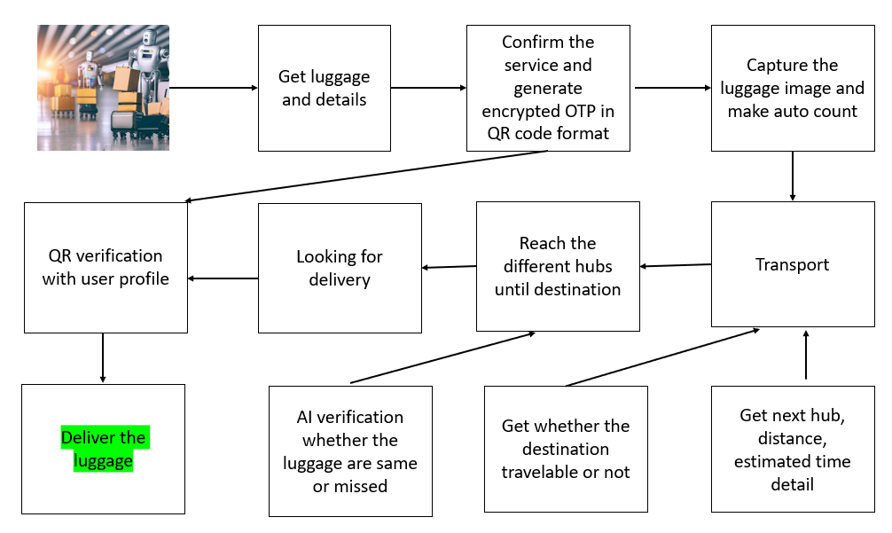
System overall architecture

Slide 13
TECHNICAL REQUIREMENTS
HARDWARE REQUIREMENTS
Intel(R) Core(TM) i5-7300U CPU @ 2.60GHz 2.71 GHz
4GB RAM
15MB Hard drive storage
SOFTWARE REQUIREMENTS
Anaconda Distribution
GPS
Vscode
Xampp Server

Slide 14
METHODOLGIES USED
Data collection and Preprocessing
Pandas
NumPy and Matplotlib
2. Time, Route Estimation
Scikit Learn
3. Zone Comfortable Detection
GPS
Scikit – learn
4. Web GUI
HTML, CSS
Bootstrap
jQuery
5. Data Management
MySQL Database
6. Object Detection
Open cv
7. Encryption
Md5 and QR code

Slide 15
Modules
Distance and Travel time detection
Hub route optimization
Destination Suitability Prediction for Safe Transport
Location based luggage tracking
Parcel verification
Encrypted OTP QR Verification
Customer sentiment analysis.

Slide 16
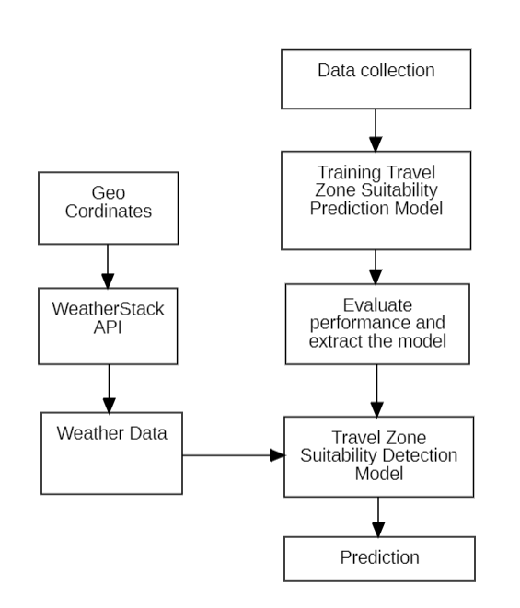
Destination suitability

Slide 17
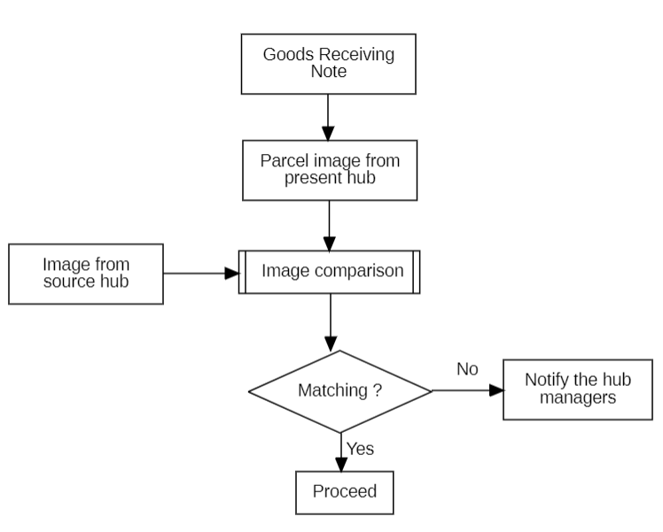
Parcel verification

Slide 18
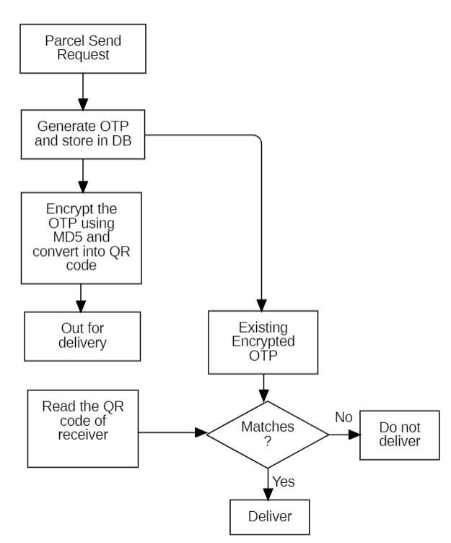
OTP ENCRYPTED QR DELIVERY

Slide 19
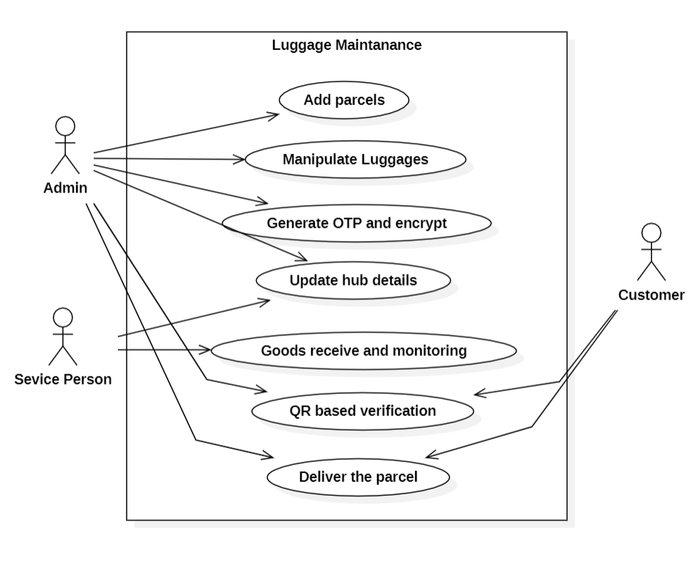
USE CASE DIAGRAM

Slide 20
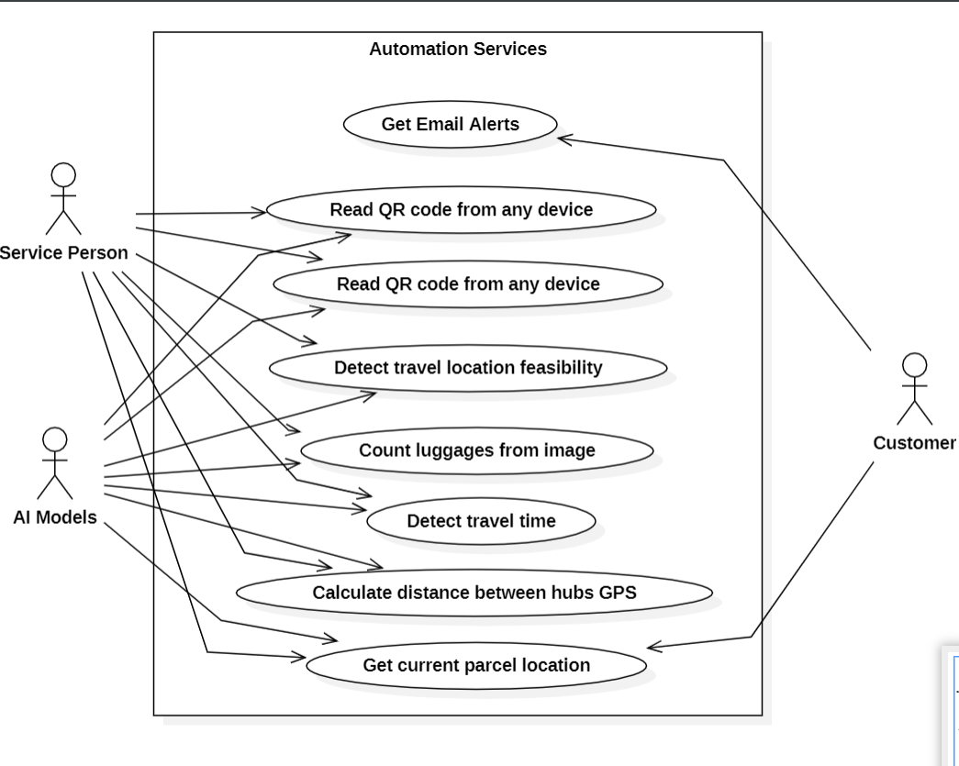
USE CASE DIAGRAM

Slide 21
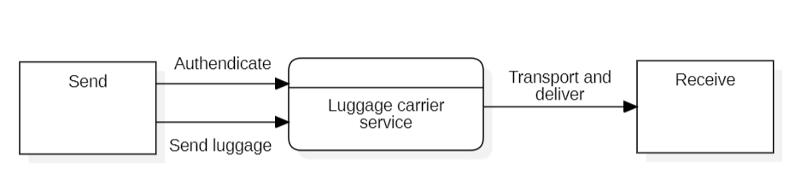
DATA FLOW DIAGRAM
LEVEL 0 DFD

Slide 22
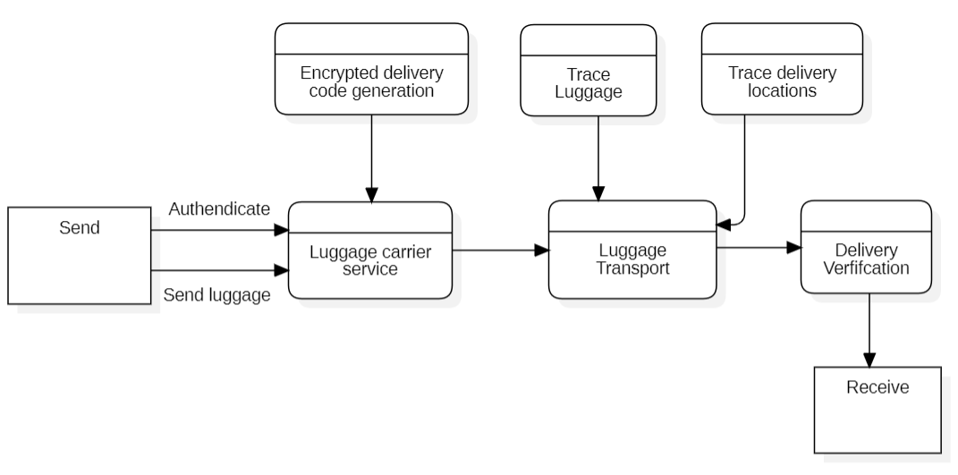
DATA FLOW DIAGRAM
LEVEL 1 DFD

Slide 23
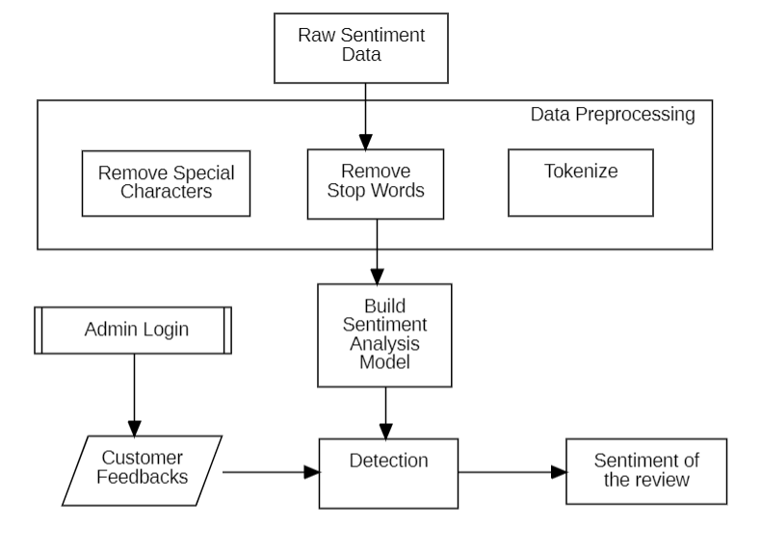
Sentiment analysis

Slide 24
PERFORMANCE ANALYSIS
The customer sentiment model was developed using goods sentiment data.
The analysis for optimal customer sentiment analysis approach included the following classifiers:
Support Vector Machine (SVM)
Random Forest (RF)
K-Nearest Neighbour (KNN)
Logistic Regression (LR)
Gradient Boosting (GB)
Accuracies for each classifier were plotted in Figure 6.
Comparison results:
SVM achieved 91% classification accuracy in predicting sentiment types.
Both SVM and RF achieved the same accuracy (91%).
SVM was faster than RF in training and testing phases.
Due to its higher speed in making predictions, SVM was selected for deployment.

Slide 25
PERFORMANCE ANALYSIS
The travel zone passability detection model was trained using 7 environmental factors and the types of accidents they can cause.
The model was developed using the following algorithms:
Gradient Boosting (GB)
Support Vector Machine (SVM)
Random Forest (RF)
K-Nearest Neighbour (KNN)
Among all the models, Gradient Boosting outperformed in detecting travel zone passability.
The Gradient Boosting model achieved 90.3% accuracy in classifying safe travel zones.
The Gradient Boosting model was extracted and integrated with a weather API.
The integration allows the model to use weather and environmental data from a user's location to suggest the possibility of safe travel in that area.

Slide 26
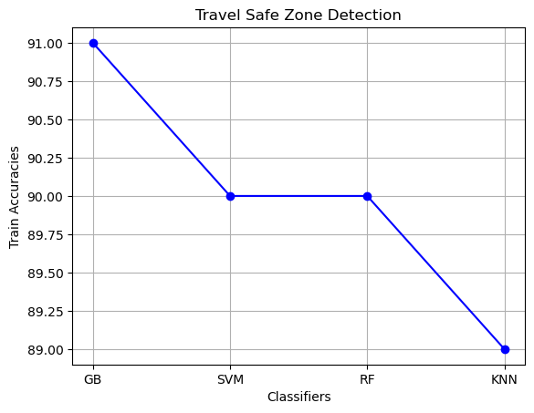
PROJECT GUI
Accuracies attained in the travel safe zone detection

Slide 27
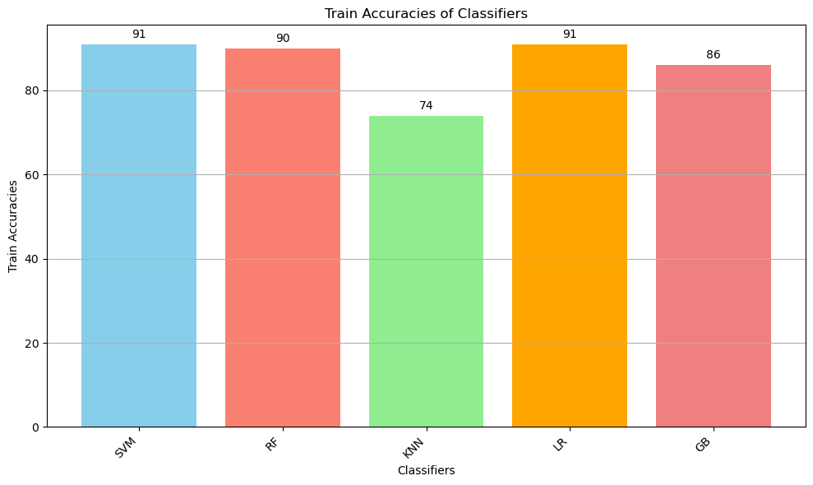
PROJECT GUI
Accuracies attained in the customer query analysis

Slide 28
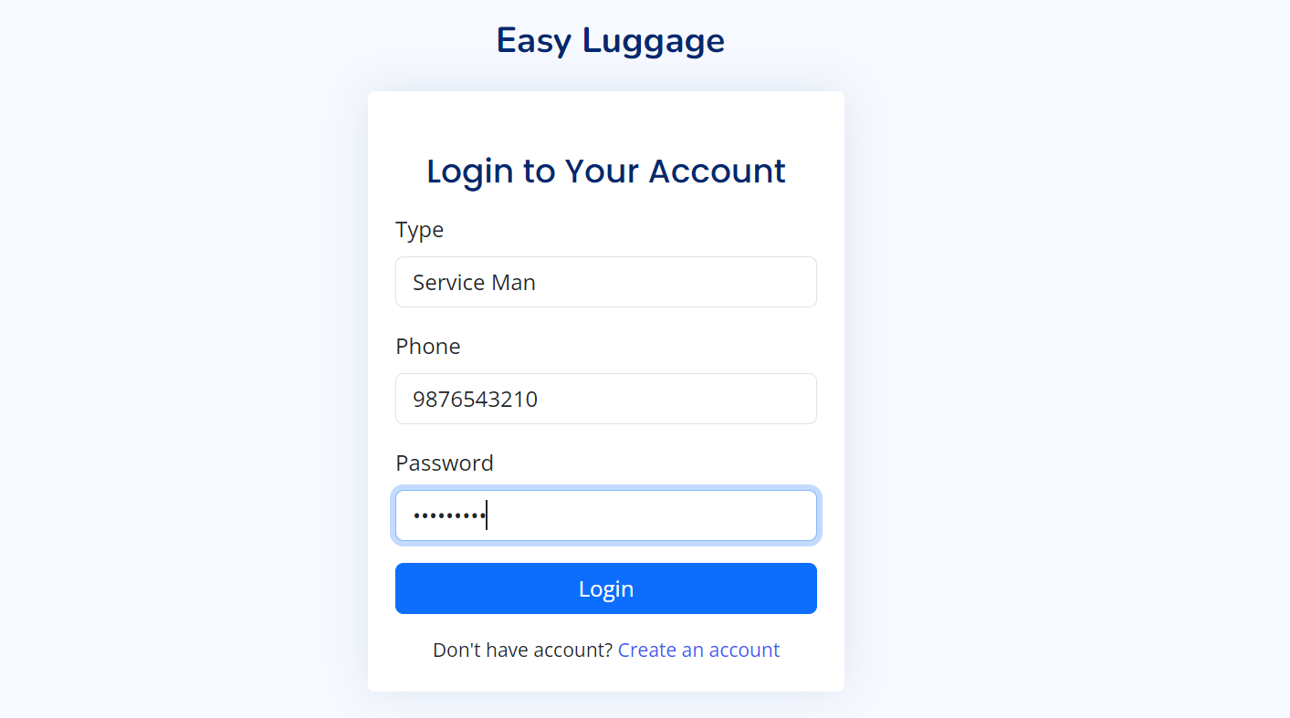
PROJECT GUI
AUTHENDICATION

Slide 29
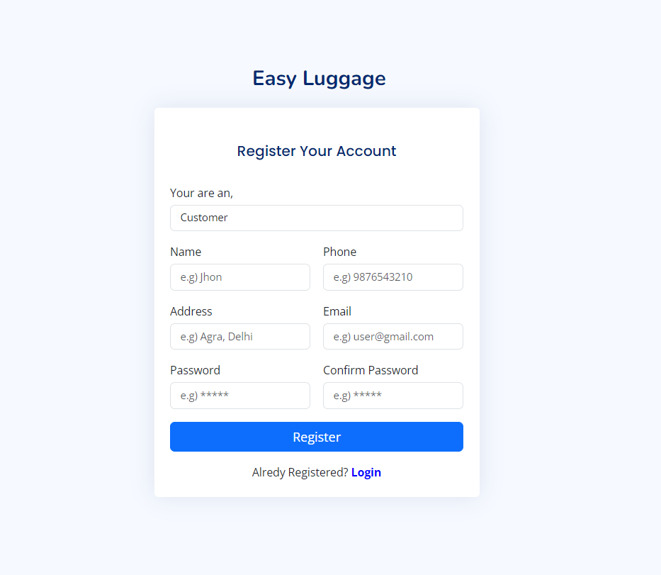
PROJECT GUI
PROFILE CREATION AND AUTHENDICATION

Slide 30
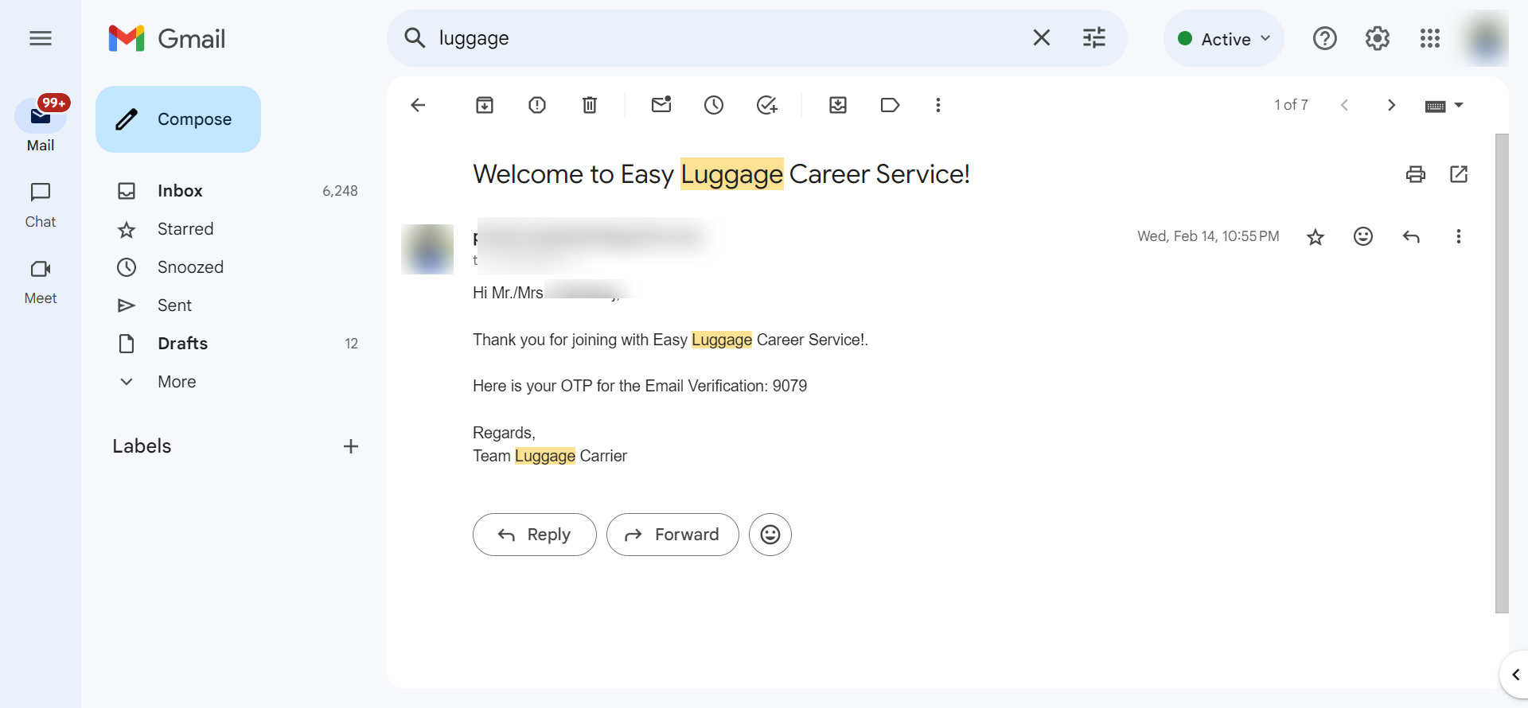
PROJECT GUI
JOINING USER OTP VERIFICATION

Slide 31

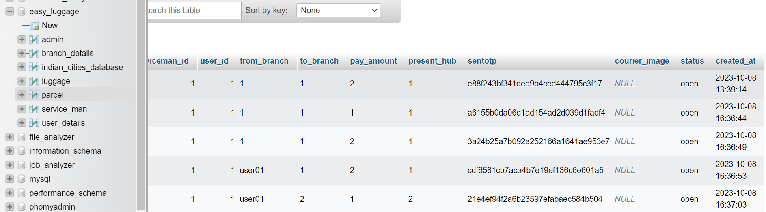
PROJECT GUI
LUGGAGE DATA WITH ENCRYPTED OTP AND GENERATED QR CODE

Slide 32
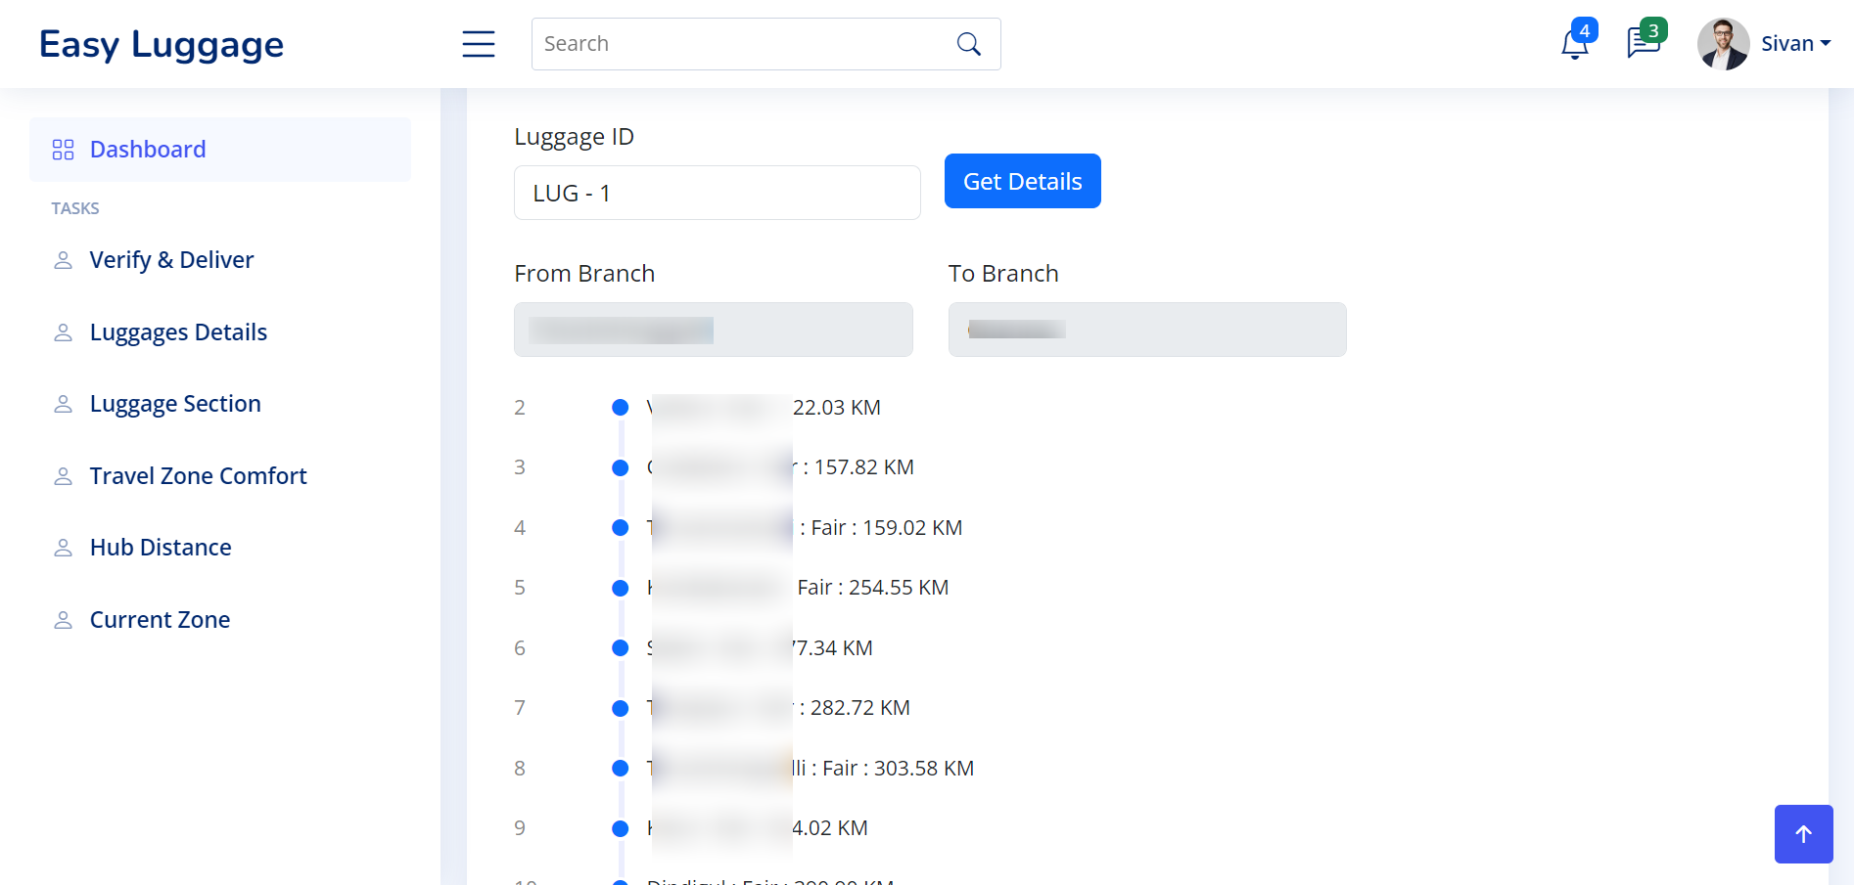
PROJECT GUI
NEXT HUB FAIR ESTIMATION USING GPS DATA

Slide 33
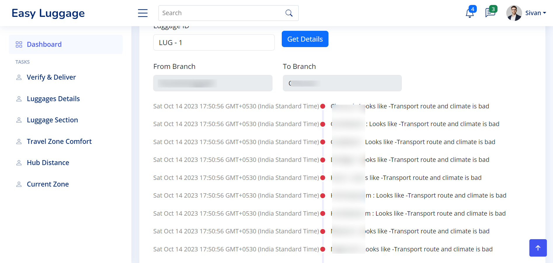
PROJECT GUI
TRANSPORT ROUTE COMPORT DETECTION

Slide 34
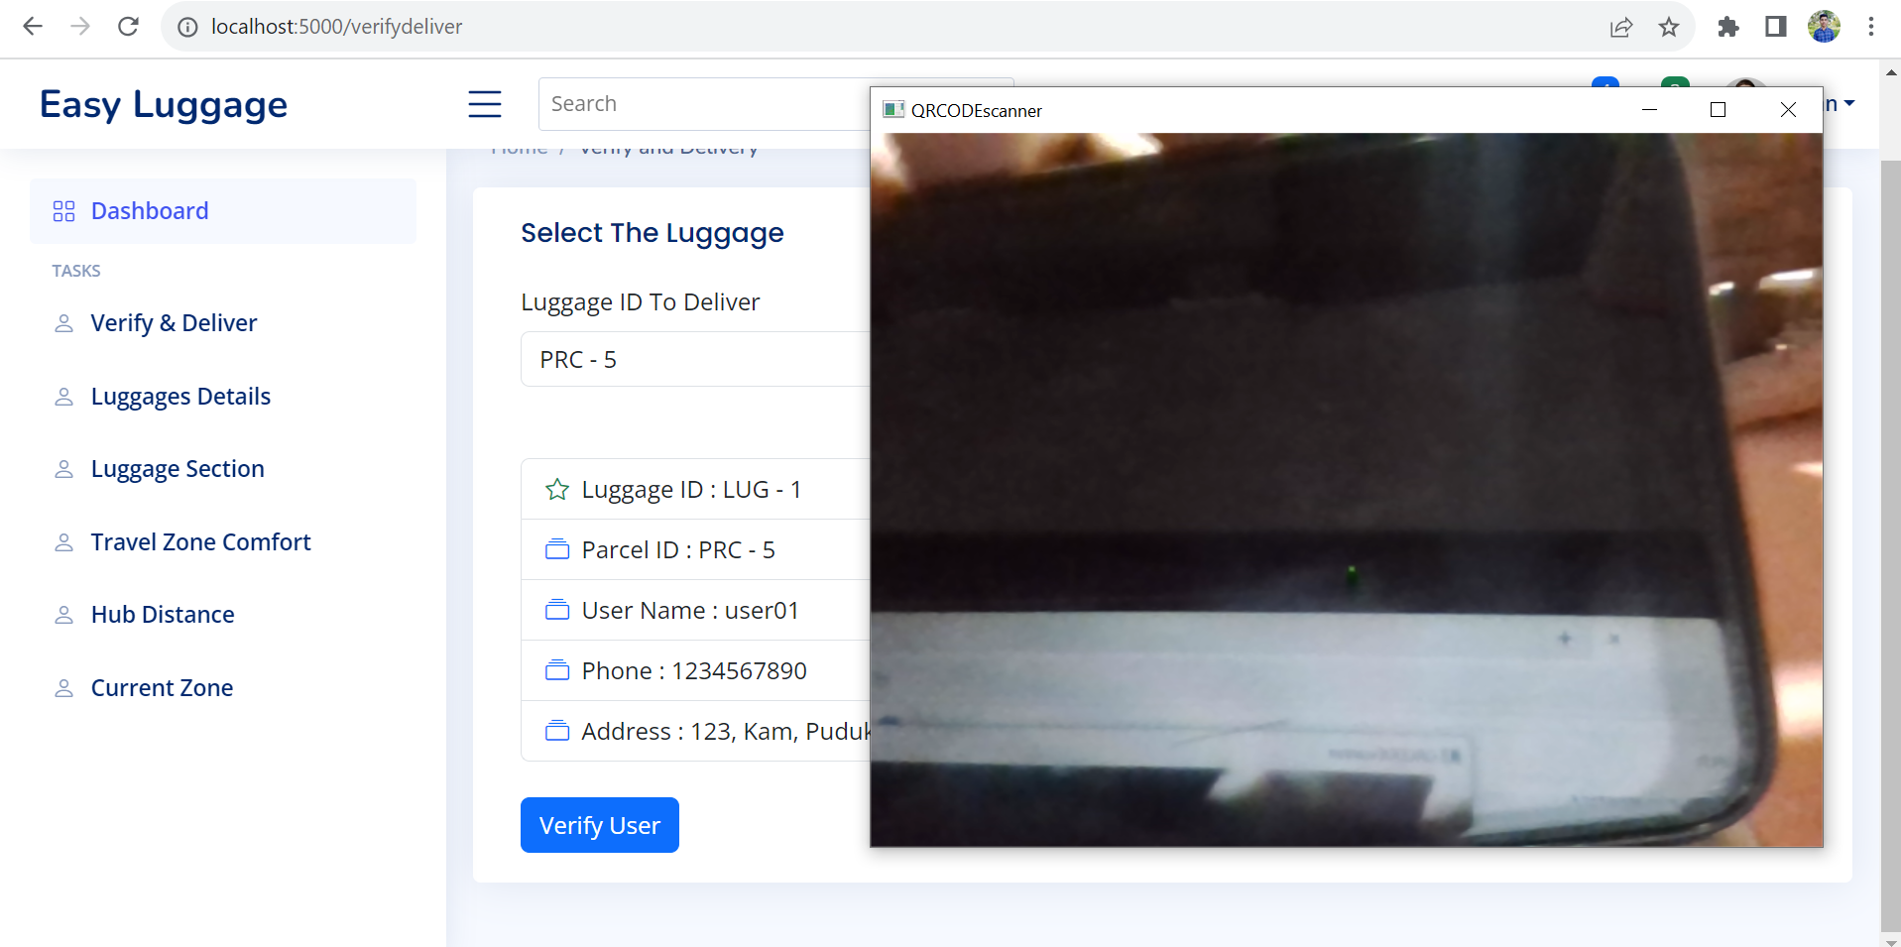
PROJECT GUI
RECEIVER QR CODE VERIFICATION

Slide 35
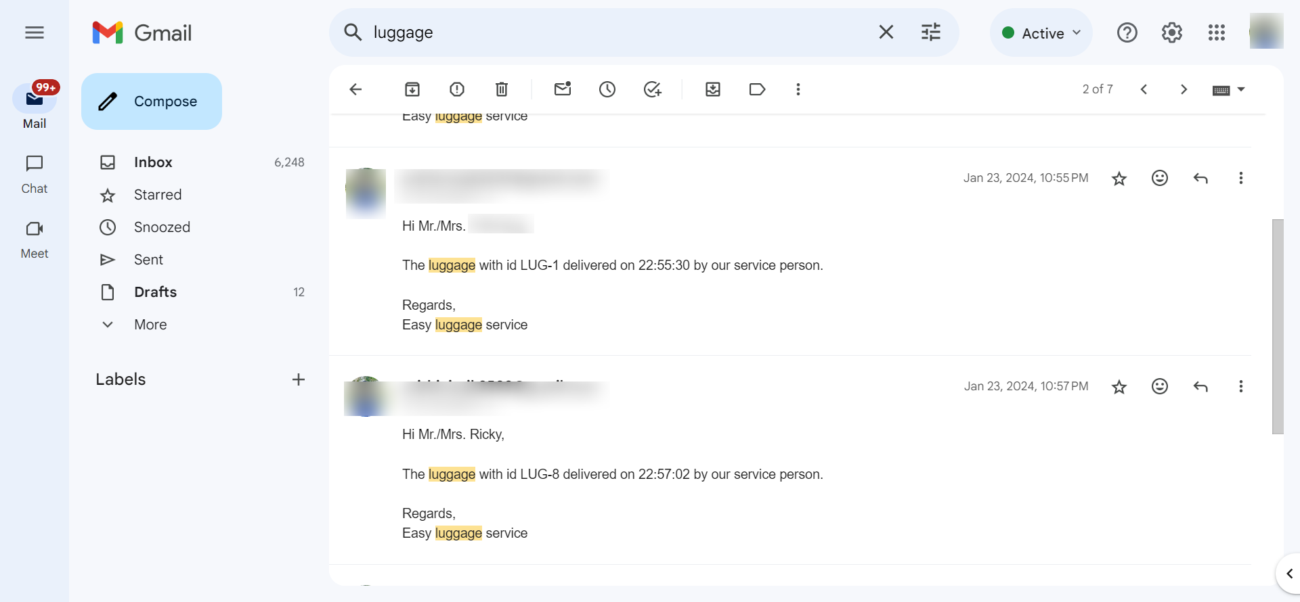
PROJECT GUI
DELIVERY CONFIRMATION

Slide 36
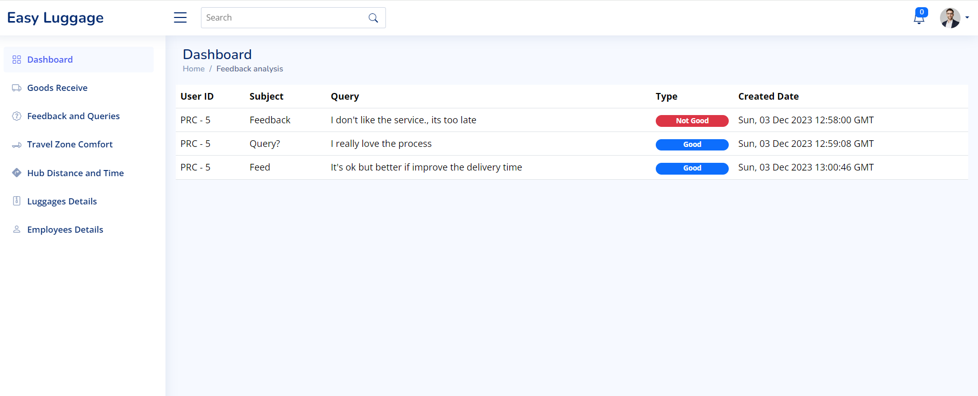
PROJECT GUI
Admin Query/ Feedback

Slide 37
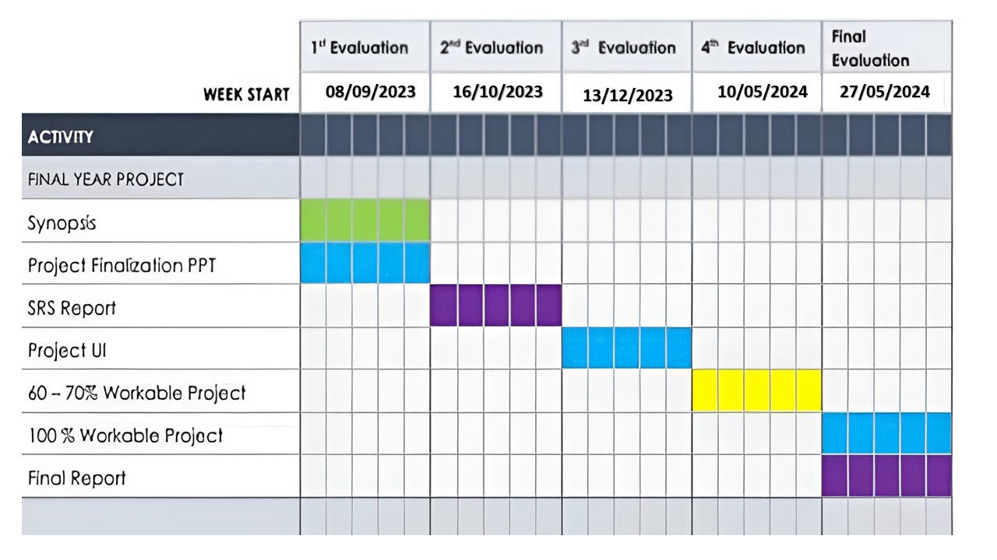
Gantt chart

Slide 38
CONCLUSION
In conclusion, the importance of a luggage carrier system today lies in its ability to overcome challenges related to increased travel, globalization, security issues, and technological advancements. This project takes a comprehensive approach by integrating AI services into logistics management applications, addressing tasks like detecting similar parcels, estimating travel times, tracking upcoming hubs, and predicting destination suitability for safe travel. With GPS services, the system precisely identifies the luggage's location during transit, triggering alerts for any deviations. To enhance security and counteract fraudulent activities, the project introduces an OTP-encoded QR code authentication mechanism, which improves upon traditional OTP methods. Additionally, incorporating sentiment analysis provides valuable insights from customer feedback and queries for ongoing system improvement. The project reduces manpower in parcel verification, routing, and tracking, while location-based transport zone comfortability detection simplifies travel in challenging areas

Slide 39
REFERENCES
[1] Kalliopi Tsolaki, Thanasis Vafeiadis, Alexandros Nizamis, Dimosthenis Ioannidis and Dimitrios Tzovaras, Utilizing machine learning on freight transportation and logistics applications: A review, ICT Express 9, Elsevier, Volume 9, Issue 3, June 2023, https://doi.org/10.1016/j.icte.2022.02.001
[2] Terence, E. and Reddy, Siva and Reddy, K. Madhu and Reddy, T. Veera, Smart Luggage Carrier System, Proceedings of the International Conference on Innovative Computing & Communication (ICICC), May 27, 2022. Available at SSRN: https://ssrn.com/abstract=4121060 or http://dx.doi.org/10.2139/ssrn.4121060
[3] Tetsuya Manabe, Kazuo Mizuno, Keisuke Hatano and Masahiko Kaneko, "Ultraviolet sterilization information provision system of baggage carts and arriving baggage for airports", IATSS Research, December 2022. DOI:10.1016/j.iatssr.2022.12.004
[4] P. L. S. Krishnan, R. Valli, R. Priya and V. Pravinkumar, Smart Luggage Carrier system with Theft Prevention and Real Time TrackingUsing Nano Arduino structure, 2020 International Conference on System, Computation, Automation and Networking (ICSCAN), Pondicherry, India, 2020, pp. 1-5, doi: 10.1109/ICSCAN49426.2020.9262445.

Slide 40
REFERENCES
[5] Afrin Khan, Bandini Nalwade, Neha Kharshinge3, Sonali Kamble, SMART LUGGAGE SYSTEM, International Research Journal of Engineering and Technology (IRJET), Volume: 06 Issue: 11, Nov 2019, https://www.irjet.net/archives/V6/i11/IRJET-V6I1130.pdf.
[6] Senthil, Sudha & Krishnamurthy, Brindha & R, Charanya. LUGGAGE TRACKING SYSTEM USING IOT. International Journal of Pure and Applied Mathematics. 117. 49-54. September 2017. https://www.researchgate.net/publication/335978445_LUGGAGE_TRACKING_SYSTEM_USING_IOT
[7] Deepti Mishra and Alok Mishra, "Improving Baggage Tracking, Security and Customer Services with RFID in the Airline Industry", Improving Baggage Tracking, Security and Customer Services with RFID in the Airline Industry, Vol. 7, No. 2, 2010.
[8] DeVries, Peter. The state of RFID for effective baggage tracking in the airline industry. IJMC. Volume6. 151-164. January 2008. 10.1504/IJMC.2008.016574.

